Slide 1
A. R. Johnson Health Science and Engineering Magnet High School Title I Input/Revision Meeting
Day: Tuesday
Date: 03/04/2025
Time: 5:00pm
Location: Lecture Hall

Slide 2
Notes:
This is our strategy map where our ultimate goal is student achievement and success.

Slide 3
Notes:
We always refer to our vision and mission

Slide 4
Welcome Parents, School Staff, and Community Members
A. R. Johnson receives money from Title I, Part A of the Elementary and Secondary Education Act, most recently reauthorized as the Every Student Succeeds Act. This law provides federal funds through the Georgia Department of Education to school systems based on high numbers or percentages of children who meet certain financial criteria. These funds are provided to help ensure that all children have an equal opportunity to succeed in school by meeting the challenging State academic content and student academic achievement standards.”
Notes:
We encourage you to ask questions throughout the meeting. We value your input! We want to make sure you leave the meeting informed about the Title I program, as well as the opportunity to provide feedback.” Have parents to complete these surveys prior to leaving the meeting.
Mcallister

Slide 5
Purpose of Meeting
“The federal law requires that each school system receiving “Title I, Part A funds” jointly develop with parents and stakeholders of all participating children. Assistance is requested in planning our family engagement activities and specifically in revising district and school policies, School Improvement Plan, School-Parent Compact, Building Staff Capacity (determining what training our staff needs to promote good school-family partnerships, and determining how best to spend our family engagement funds).
Topics are covered in a way to provided an opportunity to ask questions, offer suggestions, and participate in more detailed discussions.
Notes:
We encourage you to ask questions throughout the meeting. We value your input! We want to make sure you leave the meeting informed about the Title I program, as well as the opportunity to provide feedback.” Have parents to complete these surveys prior to leaving the meeting.
Mcallister

Slide 6
State of Title I Part A, Parent and Family Engagement-Review and Revision
Please read the LEA Policy, School Involvement Policy, and School-Parent Compact
Provide feedback for each document along with input about budget spending and school improvement plan revisions.
Write your suggestions on the input form as the documents are discussed
Remember, you have a voice at our school, USE IT!!

Slide 7
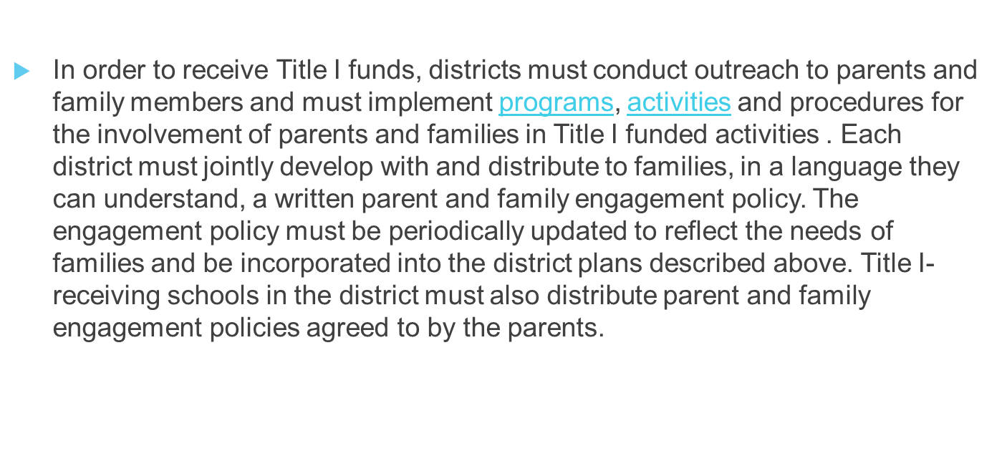
Parent and Family Engagement Policies (LEA & Schools)
Notes:
– Suggested language, “This plan describes how the school will carry out its obligation to conduct outreach and provide activities, programs, and procedures to all parents of Title I students. Based on federal law, the Georgia Department of Education requires that the plan must include, at a minimum, the following
Johnson

Slide 8
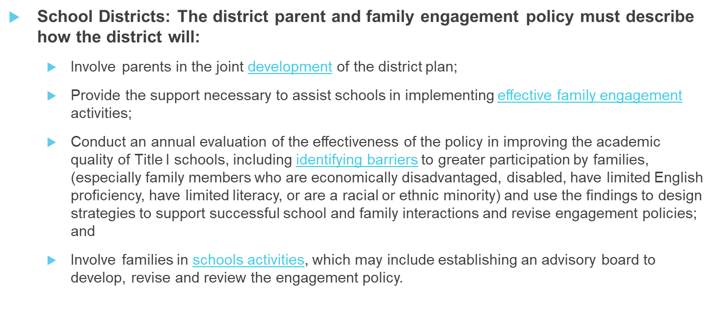
LEA PARENT AND FAMILY ENGAGEMENT POLICY
Notes:
– Suggested language, “
This plan describes how the school will carry out its obligation to conduct outreach and provide activities, programs, and procedures to all parents of Title I students.
Johnson

Slide 9
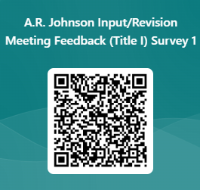
Duplicate form and put your QR Code here Input meeting Feedback *The form can also be duplicated from the link in the Canvas Course
DISTRICT POLICY INPUT
Can be found on the School Webpage : Parents, Title I
What changes do you suggest?

Slide 10
SCHOOL Parent and Family Engagement Policy
SCHOOL PARENT AND FAMILY ENGAGEMENT POLICY
Title I Schools:
The school parents and family engagement policy must describe how the school will:
Convene an annual meeting, at a convenient time to which all parents of low-income students are invited and encouraged to attend, to inform parents that their school receives Title I funds, that these funds come with requirements, and that parents have a right to be involved;
Offer a flexible number of engagement meetings at convenient times for families (for which the school may provide transportation, child care, or home visits using Title I funds);
Provide parents and families with:​
Information about Title I-funded programs;
An explanation of the curriculum and achievement levels the school uses; and
If requested, opportunities for regular meetings to participate in decisions relating to the education of their student.

Slide 11
School Parent and Family Engagement Policy Input
Can be found on the School Webpage : Parents, Title I
(Insert your School Policy)
What changes do you suggest?

Slide 12
SCHOOL-PARENT COMPACT
Jointly develop with parents and stakeholders- a school-parent compact that outlines how families, school, staff and students will share the responsibility for improved student academic achievement and develop a partnership to help students achieve state standards.
The compact must:
Describe the school's responsibility to provide high-quality curriculum and instruction in a supportive and effective learning environment that enables students to meet the academic achievement standards, and the ways in which each parent will be responsible for supporting learning, including volunteering in their child’s classroom, and participating in decisions relating to the education of their children;
Address the importance of communication between families and staff through, at a minimum:
parent-teacher conferences in elementary schools, at least annually, during which the compact will be discussed as the compact relates to the individual child's achievement;
frequent reports to parents on their children's progress; and
opportunities to volunteer in or observe their child's class
Ensure regular two-way meaningful communication between family members and school staff in a language they understand.

Slide 13
School-Parent Compact Input
Can be found on your School Webpage : Parents, Title I
What changes do you suggest?
( Insert your School- Parent Compact)

Slide 14
Building Staff Capacity
Federal law also requires that Title I schools are to educate and train teachers, specialized instructional support staff, principals, other school leaders, and other staff in how to best develop partnerships with families.
Notes:
Simon

Slide 15
Building Capacity
What suggestions do you have to train teachers and school staff?

Slide 16
TITLE I FUNDS
Title I Parent and Family Engagement Set Aside:
Each district receiving more than $500,000 in Title I Part A Funds is required to reserve at least one percent of its Title I funds to carry out parent and family engagement activities, including those described in the written policy section below. Ninety (90) percent of these “set-aside” funds must be distributed to schools, with priority given to “high-need” schools. The law further requires that parents and family members of students must be included in decisions regarding how these engagement funds are spent.
Notes:
We encourage you to ask questions throughout the meeting. We value your input! We want to make sure you leave the meeting informed about the Title I program, as well as the opportunity to provide feedback.”
Jackson

Slide 17
Title 1 Parent and Family Engagement Funds Input
IXL Learning Platform
Progress Learning
Laminator
MTSS Facilitator-salary and benefits
Media Specialist Paraprofessional-salary and benefits
What are some suggestions for the use of Parent and Family Engagement Funds?

Slide 18
A.R. Johnson Annually evaluates the schoolwide plan using data from the State’s assessments, other student performance data, and perception data to determine if the schoolwide program has been effective in addressing the major problem areas and, in turn, increasing student achievement, particularly for the lowest-achieving students. Schools must annually revise the plan, as necessary, based on student needs and the results of the evaluation to ensure continuous improvement. (ESEA section 1114(b)(3); 34 C.F.R. § 200.26(c)).
School Improvement Plan

Slide 19
School Improvement Plan Input
School Goals:
By the end of the 24-25SY, we will increase the percentage of students performing at proficient and distinguished on EOCs and EOGs in ELA to 86%, in Math-waiting on scores, in Science to 64%, and SS to 67%.
By July 2025, we will increase AP pass rate (3,4,5) from 31% to 50%.
By the end of the 2025 SY, we will increase staff retention rate from 60% to 80%.
What are some suggestions for goals and/or initiatives for the upcoming school year?

Slide 20
School Surveys
Surveys are meant to gather information that is geared to provide feedback to improve services to provide for students and parents.
Parents have a voice in what is done in the school and when the parents respond, the school knows what direction can be taken to achieve the maximum compatibility between home and community.
When a survey is given, please send back your feedback. This will help the school provide needed services for the students and parents.
Notes:
We encourage you to ask questions throughout the meeting. We value your input! We want to make sure you leave the meeting informed about the Title I program, as well as the opportunity to provide feedback.” Have parents to complete these surveys prior to leaving the meeting.

Slide 21
Annual Parent and Family Engagement Evaluation
“Each year, A. R. Johnson conducts an annual evaluation to ask parents to help us determine the effectiveness of the parent and family engagement program in improving the academic quality of the Title I schools, including identifying possible barriers to greater participation of parents in activities and programs. Additionally, school systems will use the findings from the annual evaluation to design evidence-based strategies for more effective family engagement and to revise the Title I parent and family engagement policies.”
Your window to complete this survey is April `16, 2024- May 15, 2024
Notes:
We encourage you to ask questions throughout the meeting. We value your input! We want to make sure you leave the meeting informed about the Title I program, as well as the opportunity to provide feedback.” Have parents to complete these surveys prior to leaving the meeting.
Mcallister

Slide 22
Next Steps
Your input will be used where possible for the 2025-2026 school year as we update the:
School Compact
LEA Policy
School Policy
Title I Parent Budget
School Improvement Plan
Documents will also be distributed at the school's Annual Meeting and on your school's website.

Slide 23
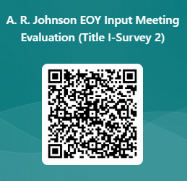
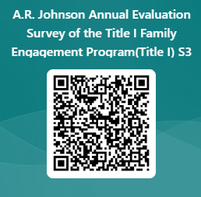
SCHOOL SURVEYS WORKSHEET
Thank you for attending our input/revision meeting. Please complete the EOY Meeting Evaluation!
{If you have any questions, please contact: Dione Bonds, 706-823-6933
Duplicate form and put your QR Code here
EOY Meeting Evaluation
*The form can also be duplicated from the link in the Canvas Course
For ESOL Parents ONLY
Parents Survey Title III, Part A
Needs Assessment Richmond County School System
Notes:
We encourage you to ask questions throughout the meeting. We value your input! We want to make sure you leave the meeting informed about the Title I program, as well as the opportunity to provide feedback.” Have parents to complete these surveys prior to leaving the meeting.
Mcallister

